Slide 1
Chapter 7
Excellence, Aesthetics,
Creativity, and Genius

Slide 2

Excellence: the acquisition of extraordinary skill in a specific area of expertise
Notes:
Innate genius theory: Excellence is the result of innate ability. That is, it is genetically determined and, therefore, experts basically are born but not made.
Learning Excellence: Learning more important than biology for the acquisition of extraordinary skills.
Intensive Practice: Can indeed mimic the superior abilities of experts.
Physical and Emotional Characteristics: If any portion of excellence is inherited, it seems likely to be physical or emotional characteristics that match with the requirements for particular sports, or personality dispositions that match with particular interest areas.

Slide 3
The Pursuit of Excellence
The Foundations of Excellence
Innate genius theory
Excellence is genetically determined and, therefore, experts basically are born but not made
Think Mozart
Learning excellence
Learning more important than biology for the acquisition of extraordinary skills
Child prodigies learn same way, but start their craft earlier and work harder at perfecting their skills
Notes:
Innate genius theory: Excellence is the result of innate ability. That is, it is genetically determined and, therefore, experts basically are born but not made.
Learning Excellence: Learning more important than biology for the acquisition of extraordinary skills.
Intensive Practice: Can indeed mimic the superior abilities of experts.
Physical and Emotional Characteristics: If any portion of excellence is inherited, it seems likely to be physical or emotional characteristics that match with the requirements for particular sports, or personality dispositions that match with particular interest areas.

Slide 4

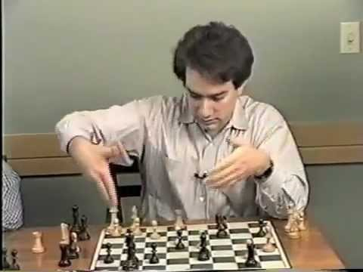
The Pursuit of Excellence
The Development of Excellence
Superior memory abilities? e.g., for chess players?…really it’s meaningfulness that counts
Grandmaster chess player
Notes:
Cognitive skills: Real excellence involves cognitive skills, the first element of which is a large knowledge base in the specific domain.
Example: Expertise in tennis requires a thorough knowledge of the game that includes familiarity with different strategies, styles of potential opponents, different types of equipment, such as rackets and shoes, and the game’s history. This knowledge base is not just a random collection of facts but an organized cluster of information that involves numerous conceptual linkages that helps in quicker and easier access to memory and problem-solving strategies.
Extensive and consistent practice: The most important factor in the acquisition of expert performance. This is important in at least three ways:
Those who truly excel at a specific discipline often begin to practice early in life; practice more hours each day or week than others.
Deliberate practice: Focused, planned, concentrated, and effortful practice. Focused on the immediate task with attention at every moment to what one is doing correctly or incorrectly.
Over-practice is harmful: Especially in sports, there is a recognized danger to what is known as overtraining. Excellence, therefore, seems to require a sensible balance of hard work and rest.

Slide 5
The Pursuit of Excellence
The Development of Excellence
Cognitive skills
Large knowledge base of chosen domain with well-organized cognitive schema
Commitment to domain
Extensive and consistent practice**
Often begin to practice early in life
Practice more hours (each day/week)
Consistent practice
Deliberate practice: focused, planned, concentrated, effortful
Notes:
Cognitive skills: Real excellence involves cognitive skills, the first element of which is a large knowledge base in the specific domain.
Example: Expertise in tennis requires a thorough knowledge of the game that includes familiarity with different strategies, styles of potential opponents, different types of equipment, such as rackets and shoes, and the game’s history. This knowledge base is not just a random collection of facts but an organized cluster of information that involves numerous conceptual linkages that helps in quicker and easier access to memory and problem-solving strategies.
Extensive and consistent practice: The most important factor in the acquisition of expert performance. This is important in at least three ways:
Those who truly excel at a specific discipline often begin to practice early in life; practice more hours each day or week than others.
Deliberate practice: Focused, planned, concentrated, and effortful practice. Focused on the immediate task with attention at every moment to what one is doing correctly or incorrectly.
Over-practice is harmful: Especially in sports, there is a recognized danger to what is known as overtraining. Excellence, therefore, seems to require a sensible balance of hard work and rest.

Slide 6
The Pursuit of Excellence
The Development of Excellence
10,000 Hours Claim
Ericson has said this is untrue and an inaccurate representation of his research
Excellence in some skills may take more than 10,000 hours, other less than 10,000
Notes:
Cognitive skills: Real excellence involves cognitive skills, the first element of which is a large knowledge base in the specific domain.
Example: Expertise in tennis requires a thorough knowledge of the game that includes familiarity with different strategies, styles of potential opponents, different types of equipment, such as rackets and shoes, and the game’s history. This knowledge base is not just a random collection of facts but an organized cluster of information that involves numerous conceptual linkages that helps in quicker and easier access to memory and problem-solving strategies.
Extensive and consistent practice: The most important factor in the acquisition of expert performance. This is important in at least three ways:
Those who truly excel at a specific discipline often begin to practice early in life; practice more hours each day or week than others.
Deliberate practice: Focused, planned, concentrated, and effortful practice. Focused on the immediate task with attention at every moment to what one is doing correctly or incorrectly.
Over-practice is harmful: Especially in sports, there is a recognized danger to what is known as overtraining. Excellence, therefore, seems to require a sensible balance of hard work and rest.

Slide 7
The Pursuit of Excellence
The Development of Excellence
Over-practice is harmful
Recognized danger to what is known as overtraining
Excellence requires a sensible balance of hard work and rest (practice about 4 hr/day by those who achieve high level of excellence)
Notes:
Cognitive skills: Real excellence involves cognitive skills, the first element of which is a large knowledge base in the specific domain.
Example: Expertise in tennis requires a thorough knowledge of the game that includes familiarity with different strategies, styles of potential opponents, different types of equipment, such as rackets and shoes, and the game’s history. This knowledge base is not just a random collection of facts but an organized cluster of information that involves numerous conceptual linkages that helps in quicker and easier access to memory and problem-solving strategies.
Extensive and consistent practice: The most important factor in the acquisition of expert performance. This is important in at least three ways:
Those who truly excel at a specific discipline often begin to practice early in life; practice more hours each day or week than others.
Deliberate practice: Focused, planned, concentrated, and effortful practice. Focused on the immediate task with attention at every moment to what one is doing correctly or incorrectly.
Over-practice is harmful: Especially in sports, there is a recognized danger to what is known as overtraining. Excellence, therefore, seems to require a sensible balance of hard work and rest.

Slide 8

The Pursuit of Excellence
The Development of Excellence: The 10-Yr Rule
It takes at least 10 years of dedicated, consistent practice to attain a high level of excellence
Peak age varies: Age at which people generally attain recognition and make their big breakthroughs varies across disciplines
Frank Lloyd Wright (age 69) Fallingwater house
Fallingwater House Frank Lloyd Wright
Notes:
Peak age varies: Age at which people generally attain recognition and make their big breakthroughs varies across disciplines.
Example: Peak age for creative achievement in mathematics, physics, and lyric poetry occurs in the late 20s and early 30s, while the peak age in philosophy and for writing fiction is the late 40s and early 50s.

Slide 9
The Pursuit of Excellence
Resonance
Cyclical process that guides development of excellence in many areas of expertise
Performance excellence byproduct of living life: Living life in a way that people are fully engaged in what they do
Notes:
Performance excellence byproduct of living life: Living life in a way that people are fully engaged in what they do.
Four stages of Resonance Performance Model:
Dream or the feelings a person experiences when engaged in an activity.
Preparation along with consistent engaged practice.
Obstacles that people encounter inevitably.
Revisit dream or reconnect with feelings that sparked dream. This reconnection with original feelings allows a person to embrace the obstacles, avoid the trap of trying harder and enjoying it less, and thereby move forward.

Slide 10
The Pursuit of Excellence
Resonance
Four stages of Resonance Performance Model
Dream: the feelings a person experiences when engaged in an activity
Preparation along with consistent engaged practice
Obstacles that people encounter inevitably
Revisit dream or reconnect with feelings that sparked dream. This reconnection with original feelings allows a person to embrace the obstacles, avoid the trap of trying harder and enjoying it less, and thereby move forward
Notes:
Performance excellence byproduct of living life: Living life in a way that people are fully engaged in what they do.
Four stages of Resonance Performance Model:
Dream or the feelings a person experiences when engaged in an activity.
Preparation along with consistent engaged practice.
Obstacles that people encounter inevitably.
Revisit dream or reconnect with feelings that sparked dream. This reconnection with original feelings allows a person to embrace the obstacles, avoid the trap of trying harder and enjoying it less, and thereby move forward.

Slide 11
The Pursuit of Excellence
Passion
Intense interest and personal commitment to an activity regarded as central to one’s self
Dualistic model
Harmonious passion
Result of autonomous motivation
Freely chosen
“Fits” identity
is engaged in joyously and effortlessly
Flow is often experienced
Obsessive passion
Notes:
Harmonious passion: Result of autonomous motivation, is freely chosen, “fits” identity, and is engaged in joyously and effortlessly.
Obsessive passion: Results from feelings of being controlled, often involves rigid persistence, and may create conflicts within one’s identity and life, as well as feelings of anxiety and even shame. Examples: Gambling, Internet preoccupations
Harmonious passion has positive effects on health and well-being, while obsessive passion is related to diminished health. Example: Risk of burnout especially among older persons
Hedonic and eudemonic well-being: Harmonious passion may also play a role in both hedonic and eudemonic well-being. Harmonious passion for an activity can trigger positive emotions that in turn help nurture meaning and personal growth.

Slide 12
The Pursuit of Excellence
Passion
Dualistic model
Harmonious passion
Obsessive passion
Results from feelings of being controlled
Often involves rigid persistence
May create conflicts within one’s identity and life, as well as feelings of anxiety and even shame.
Examples: Gambling, Internet preoccupations
Notes:
Harmonious passion: Result of autonomous motivation, is freely chosen, “fits” identity, and is engaged in joyously and effortlessly.
Obsessive passion: Results from feelings of being controlled, often involves rigid persistence, and may create conflicts within one’s identity and life, as well as feelings of anxiety and even shame. Examples: Gambling, Internet preoccupations
Harmonious passion has positive effects on health and well-being, while obsessive passion is related to diminished health. Example: Risk of burnout especially among older persons
Hedonic and eudemonic well-being: Harmonious passion may also play a role in both hedonic and eudemonic well-being. Harmonious passion for an activity can trigger positive emotions that in turn help nurture meaning and personal growth.

Slide 13
The Pursuit of Excellence
Passion
Dualistic model
Harmonious passion, Obsessive passion
Harmonious passion has positive effects on health and well-being
Harmonious passion in sports: greatest effects if it helps meet one’s needs for autonomy, competence, relatedness, and achievement
Notes:
Harmonious passion: Result of autonomous motivation, is freely chosen, “fits” identity, and is engaged in joyously and effortlessly.
Obsessive passion: Results from feelings of being controlled, often involves rigid persistence, and may create conflicts within one’s identity and life, as well as feelings of anxiety and even shame. Examples: Gambling, Internet preoccupations
Harmonious passion has positive effects on health and well-being, while obsessive passion is related to diminished health. Example: Risk of burnout especially among older persons
Hedonic and eudemonic well-being: Harmonious passion may also play a role in both hedonic and eudemonic well-being. Harmonious passion for an activity can trigger positive emotions that in turn help nurture meaning and personal growth.

Slide 14

The Pursuit of Excellence
Grit
Duckworth’s definition
Combination of passion and persistence
Key element responsible for higher achievement and success
Better predictor of academic performance than both IQ and SAT scores
Increases with age
Effortful persistence
A meta-analysis by Credé, Tynan and Harms (2017) concluded that “the primary utility of the grit construct may lie in the perseverance facet.”
Notes:
Duckworth’s definition: Angela Lee Duckworth combined the ideas of passion and persistence into a new construct she calls grit. Self-disciplined people who score high on measures of persistence and passion toward their goals are high in grit.
Effortful persistence: A meta-analysis by Credé, Tynan and Harms (2017) concluded that “the primary utility of the grit construct may lie in the perseverance facet.”
However, too much grit can be “too much of a good thing.” For instance, Lucas, Gratch, Cheng, and Marsella (2015) found that people high on grit were more likely to persist even when they would incur costs and negative outcomes. That is, sustained persistence toward a goal that can never be reached will often decrease well-being.

Slide 15
Aesthetics and the Good Life
Aesthetics is an appreciation of the beautiful and the sublime
Why is this a section in this chapter?
Relationship between beauty and creativity
A way to conceptualize aesthetics is in terms of an appreciation of excellence
One of 24 virtues listed in VIA
Appreciation of beauty and excellence
Appreciation of Beauty and Excellence Scale (ABE)
Notes:
One of 24 virtues listed in Values in Action (VIA): In the discussion of strengths, virtues, and values in Chapter 2, one of the 24 virtues listed in the Values in Action (VIA) classification system is “Appreciation of beauty and excellence.”
Appreciation of Beauty and Excellence Scale (ABE) created to remedy neglect in research.

Slide 16
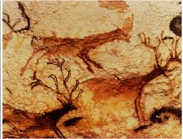
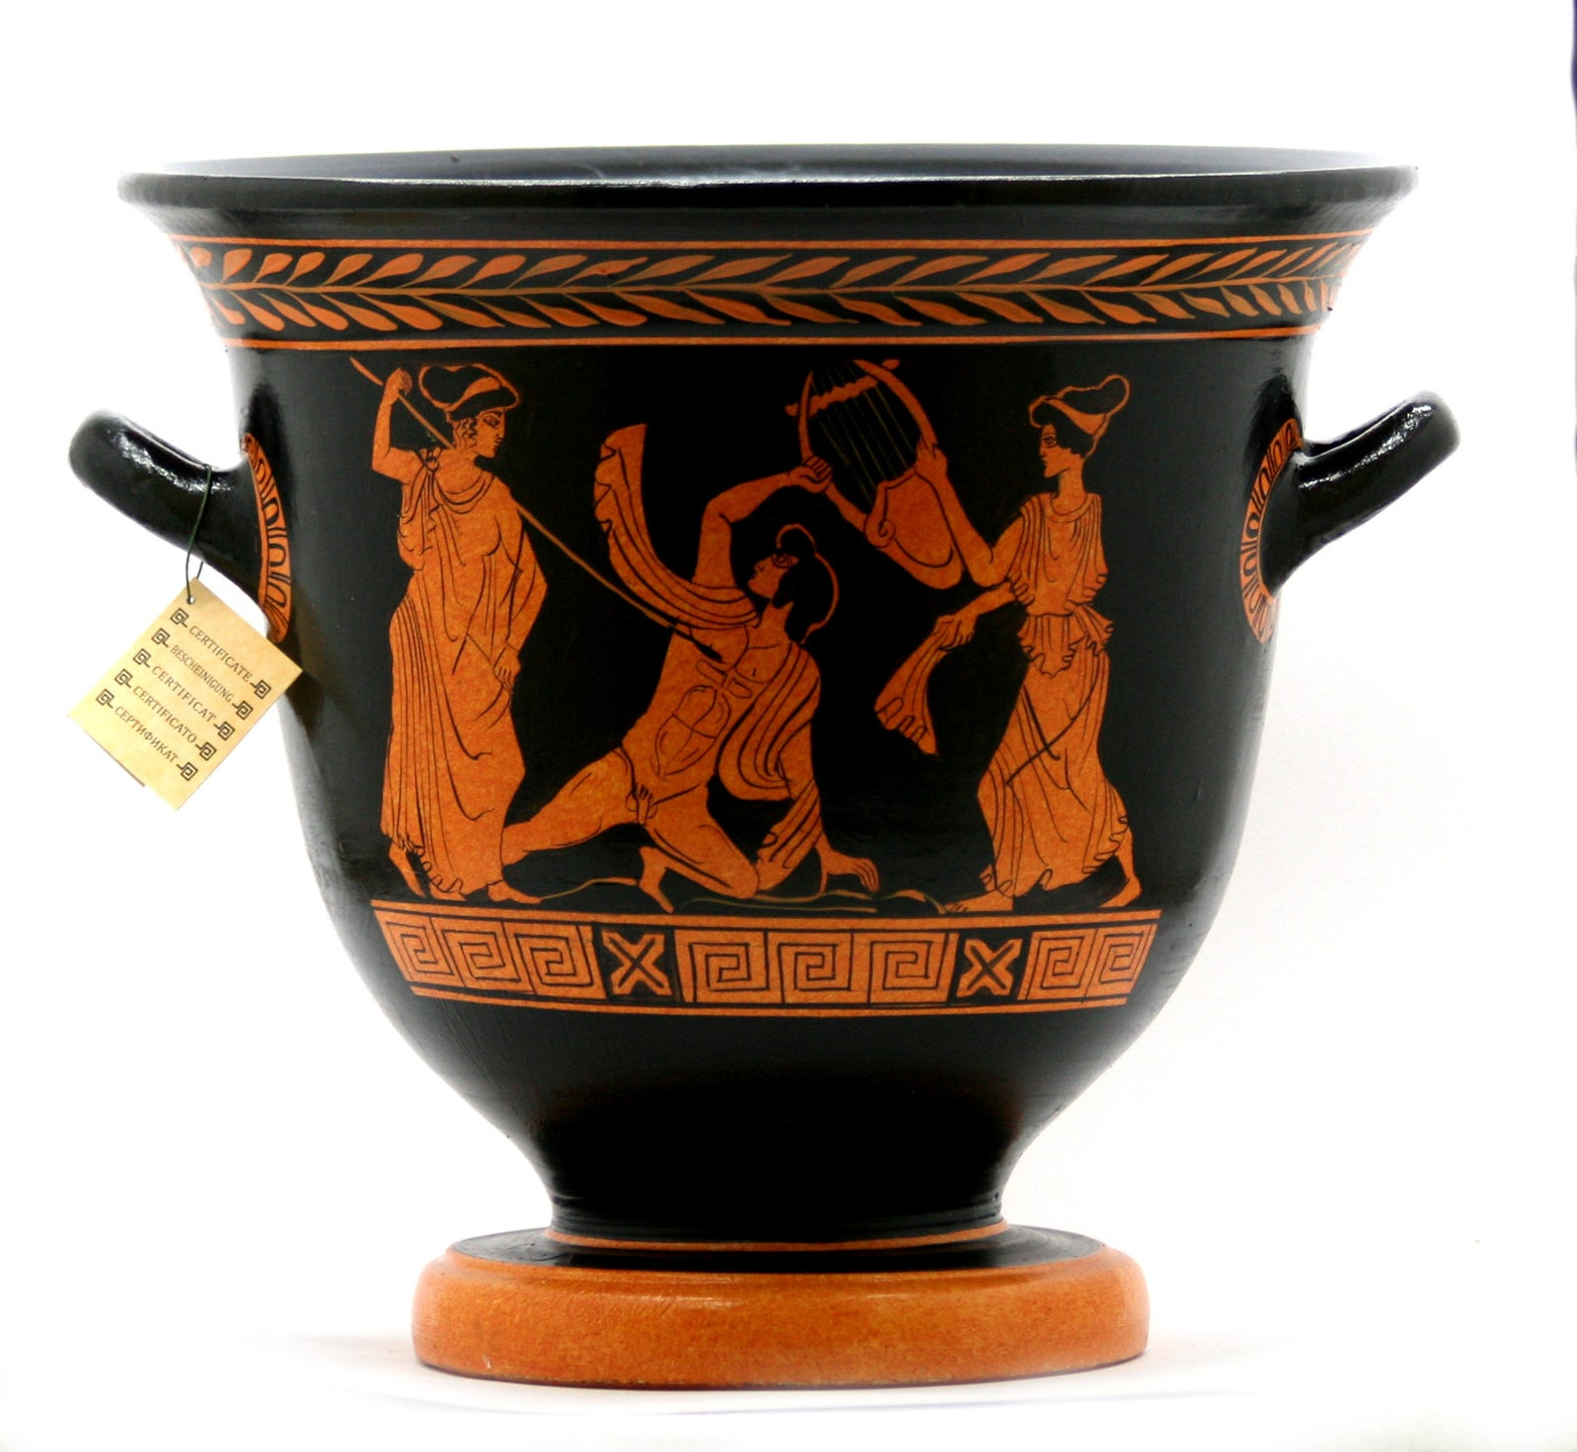

Aesthetics and the Good Life
Why Is the Aesthetic Sense Important?
Desire to stimulate the aesthetic sense since beginnings of humanity
Art and creativity increase sense of well-being, life satisfaction, and happiness
Art as a tool for social change
One of the first changes that dictators often initiate is to suppress forms of art unacceptable to their political ideology
Notes:
Desire to stimulate the aesthetic sense since beginnings of humanity:
Example: The beautiful cave paintings at Lascaux and Vallon-Pont-d’Arc, France, which are 12,000 to 20,000 years old.
Art as a tool for social change:
Example: One of the first changes that dictators often initiate is to suppress forms of art unacceptable to their political ideology.

Slide 17
Aesthetics and the Good Life
Four Attributes of the Aesthetic Experience
Pleasure
Gazing at attractive object increases sense of well-being
Artwork serves as reminders of places visited, or things and people loved
Also serves as a stimulus for positive emotions
Putting pictures of family, pets on our desk

Slide 18
Aesthetics and the Good Life
Four Attributes of the Aesthetic Experience
Absorption
Appreciation of art builds on experience which intensifies the sense of immediate living
Aesthetic sense necessary for well-being because it creates a heightened vitality that is restorative
Notes:
Appreciation of art builds on experience: Appreciation of art builds on experience that intensifies the sense of immediate living
Aesthetic sense necessary for well-being: Creates a heightened vitality that is restorative. Heightens awareness, energizes appreciation of the experience of the moment, and allows a more complete “interpenetrating of self and the world of objects and events”.

Slide 19
Aesthetics and the Good Life
Four Attributes of the Aesthetic Experience
Intrinsic interest
Aesthetics helps us learn about the world around us
Stimulates sense of curiosity
Fosters intellectual development
Mozart effect
May be that those who are more educated are the ones who are most likely to play Mozart for kids
Notes:
Mozart effect: In the popular media, the “Mozart Effect” is supposed to be a facilitator of intelligence. Listening to Mozart’s music, it was said, helped children learn, even those still in the womb. However, the researchers who conducted the original studies never claimed that listening to Mozart’s music enhanced intelligence and therefore felt obligated to write a rejoinder to all the misinformation about their work (Evans, 2010).

Slide 20
Aesthetics and the Good Life
Four Attributes of the Aesthetic Experience
Challenge
Aesthetics a pathway to greater personal growth
Art can be used to express emotions, intuitions, meanings
Helps us look deeper within ourselves:
To search for new ways to express emotions, and to help us step outside our personal comfort zones to experience life in fresh ways
Stimulates people to think and feel differently
Profound impact on sense of identity and emotional security
Notes:
Aesthetics a pathway to greater personal growth: Art can be used to express emotions, intuitions, and meanings that people find hard to express in words. For example: Poetry is the art of using words to express something that lies beyond the words themselves.
Helps us to look deeper within ourselves: To search for new ways to express emotions, and to help us step outside our personal comfort zones to experience life in fresh ways.
Rallying cry of avant-garde movement: Movement that began in the 19th century. Avant-garde artists set out to shake up the bourgeoisie, whom they criticized as overcontrolled, emotionally timid, and stifled by a rigid social system that demanded conformity rather than creativity.

Slide 21

Aesthetics and the Good Life
Music and Well-Being
Effective way to induce certain moods
Positive or negative/sad
Ability to recognize distinct emotions in music relates to EQ
Notes:
Seligman’s PERMA model of impact of music on happiness and life satisfaction: Seligman’s model posits that well-being can be predicted by examining five factors: Positive emotions, engagement in life, positive relationships, meaningfulness, and accomplishments (i.e., PERMA).
Heavy metal, grunge rock, and techno music: These types of music can be psychological harmful
Using the right kind of music can help enhance mental clarity, tension, and cardiovascular health.

Slide 22
Aesthetics and the Good Life
Music and Well-Being
Effects of listening to classical music or meditation/relaxing music (mood, mental clarity, tension, cardiovascular health improvements) versus heavy metal, grunge rock, and techno music (physiologically harmful)
Fans of music with death themes/torture/warfare may think it gives them freedom to express feelings in safe environment, but this type of music tends to reinforce one’s violence and despair
Notes:
Seligman’s PERMA model of impact of music on happiness and life satisfaction: Seligman’s model posits that well-being can be predicted by examining five factors: Positive emotions, engagement in life, positive relationships, meaningfulness, and accomplishments (i.e., PERMA).
Heavy metal, grunge rock, and techno music: These types of music can be psychological harmful
Using the right kind of music can help enhance mental clarity, tension, and cardiovascular health.

Slide 23
Aesthetics and the Good Life
Music and Well-Being
Seligman and PERMA
Positive emotion (prior slide)
Engagement with music
Can engage in flow, savoring when listening to music
Social relationships
Can enhance relationships (romantic song, similar musical tastes, music festivals…emotional contagion)
Meaning (e.g., “Deadheads”)
Accomplishment
Notes:
Seligman’s PERMA model of impact of music on happiness and life satisfaction: Seligman’s model posits that well-being can be predicted by examining five factors: Positive emotions, engagement in life, positive relationships, meaningfulness, and accomplishments (i.e., PERMA).
Heavy metal, grunge rock, and techno music: These types of music can be psychological harmful
Using the right kind of music can help enhance mental clarity, tension, and cardiovascular health.

Slide 24
Aesthetics and the Good Life
Music and Well-Being
Music and health
Helps patients heal faster after surgery
Helps cancer patients with healing process
Boosts immune system
Helps children raise scholastic scores
Improves well-being of hospitalized children
Use of music therapy as part of healing process
Singing increases oxytocin levels
Music-making increases well-being and neuroplactity in older persons
Notes:
Music helps healing process: Collection of papers by the New York Academy of Sciences entitled Biological Foundations of Music indicate that music can help patients heal faster after surgery, help cancer patients with the healing process, help Alzheimer’s patients to remember events from their past, and help people cope better with severe pain.

Slide 25
Aesthetics and the Good Life
Music and Well-Being
Music and the brain
Music leads to increased brain size (but, scope of research is limited…compared musicians to non-musicians…rather than a longitudinal study)
Stimulates dopamine release
Benefits of playing music
Activates regions of the brain involved in experience of pleasure, euphoria, and craving
Notes:
Benefits of playing music:
Example: Studies have found that 3- and 4-year old children who learned how to play the piano scored 34% higher on tests of abstract reasoning skills than children who were taught computer skills. Other studies have found that children with attention deficit hyperactivity disorder learned to concentrate better and control their aggression better after playing games based on musical rhythms.

Slide 26
Aesthetics and the Good Life
Art, Dance, Crafts, and Well-Being
Artistic expression increases feelings of well-being
Helps to deal with emotions associated with cancer
Helps adjustment to dementia, chronic disability, enhances stress reduction
Tool for older persons to adjust to aging and increase life satisfaction and sense of meaning
College students and “beauty log” (beautiful events in nature, or objects made, or events morally beautiful/inspirational) related to increased hope and WB

Slide 27
Aesthetics and the Good Life
Finding Beauty Outside the Arts
Beauty in many guises
Suggestions that scientific theory be judged partially on its elegance or aesthetic appeal
Notes:
Beauty in many guises: The beauty of a scientific theory, a mathematical equation, or the sheer immensity of the universe emotionally moves many scientists
Suggestions on scientific theory to be judged partially on its elegance or aesthetic appeal:
Example: Susan Fitzpatrick recalled how she entered the field of science because of the beauty she saw in Krebs cycle of cellular respiration. Fitzpatrick’s story about beauty was about the world’s most demanding bicycle race, Tour de France.

Slide 28
Aesthetics and the Good Life
Origins of the Aesthetic Sense
Kaplan’s savannah hypothesis…evolutionary significance in interest and curiosity surrounding landscapes
Emotional responses to certain forms and images a result of innate responses from deep collective unconscious
Aesthetic sense evolved from early attachment between mothers and infants
Judgment of what is beautiful learned from culture and historical period
Notes:
Kaplan’s savannah hypothesis: Finds evolutionary significance in our elemental interest and curiosity about landscapes, insofar as such traits encouraged early humans to explore their environment.
Emotional responses to forms and images a result of innate responses from deep collective unconscious: Carl Jung
Aesthetic sense evolved from early attachment between mothers and infants: proposed by Ellen Dissanayake
Judgment of what is beautiful learned from culture and historical period:
Example: Many people in Western societies find the music of India to be strangely discomforting, primarily because Indian music uses a quartertone scale while Western music uses a halftone scale. Similarly, the highly stylized form of Japanese drama called Noh is completely incomprehensible for most Westerners, even though the aesthetic of Japanese gardens is very accessible.

Slide 29

Aesthetics and the Good Life
Can Tragedy and Sadness Be Beautiful?
Tragic events are part of life
Power of artistic tragedy is paradoxical
Experience tragedy but gain benefits
Leads to experiences of emotions of compassion, hope, relief, empathy, and courageous resolve
Compassion makes us want to prevent future tragedies
Helps us experience tragic moments and feel emotions through a substitute
Notes:
Tragic events are part of life: In order to face human mortality, people must inevitably confront sadness in some way.
Power of artistic tragedy is paradoxical: Art enables people to experience tragedy and gain three benefits: empathy for characters reminds us of our shared humanity and may even serve to increase compassion and charity; compassion that helps us to resolve not to allow such tragedies to occur if we can prevent them; feel emotions through a substitute.

Slide 30

Creativity
What Is Creativity?
Development of creativity shares most characteristics of excellence but adds certain cognitive styles
Difficult quality to pin down
Defined as “adaptive originality”
Should make a meaningful contribution to culture
What’s considered meaningful? Think Van Gogh who only sold one painting in his lifetime
Assessment of creativity applies to wide range of behaviors
Notes:
Defined as “adaptive originality”: by Dean Simonton (2009). To be creative, an idea or product must be original, novel, surprising, or unexpected and it must also be adaptive--that is, it must provide a useful solution to a real-life problem. These dual criteria mean that if you are the only person to see your latest painting as inventive, inspiring, and original, then it really isn’t creative.
Should make a meaningful contribution to culture: by John Nicholls (1972). If we find a novel and unique solution to the problem of how to dust our apartment, it may be considered clever but it may not be true creativity.

Slide 31

Creativity
Little-c and Big-C Creativity
Little-c creativity enhances life by finding unique solutions
Referred to as everyday creativity for routine or common problems
Big-C creativity: Transforms culture and history
Associate with genius
Notes:
Little-c creativity: Unique solutions, not necessarily groundbreaking innovations

Slide 32
Creativity
Research Perspectives on Creativity
Difficulty of measuring creativity quantifiably
Creativity can be recognized…in general we recognize things as creative
Creativity in one domain only moderately associated with creativity in a different domain
Artistic excellence in one area does not translate into excellence in another
Notes:
Difficulty of measuring creativity quantifiably: Psychologists usually measure relative degrees of creativity.
Creativity in one domain only moderately associated with creativity in a different domain: Painting and writing
Four research traditions dominate studies of creativity: Focusing on person, process, press, and product, respectively.
Studies of creative persons tend to investigate personality traits or other attributes associated with individuals. Process studies look at how creativity happens. Press refers to the environmental influences that may help or hinder creativity. Finally, a product approach focuses on actual outcomes of creativity.

Slide 33
Creativity
Research Perspectives on Creativity
Four research traditions dominate studies of creativity
Person: Investigate personality traits or other attributes associated with individuals
Process studies look at how creativity happens
Press the environmental influences that may help or hinder creativity
Product approach focuses on actual outcomes of creativity
Notes:
Difficulty of measuring creativity quantifiably: Psychologists usually measure relative degrees of creativity.
Creativity in one domain only moderately associated with creativity in a different domain: Painting and writing
Four research traditions dominate studies of creativity: Focusing on person, process, press, and product, respectively.
Studies of creative persons tend to investigate personality traits or other attributes associated with individuals. Process studies look at how creativity happens. Press refers to the environmental influences that may help or hinder creativity. Finally, a product approach focuses on actual outcomes of creativity.

Slide 34
Creativity
Research Perspectives on Creativity
The Creative Person
Personality traits overlap with those who achieve excellence
Consistent traits of creative people
Openness to experience…highly flexible in thinking, tolerant of ambiguity
Independent (resist conventions, work alone
Intrinsic motivation
Notes:
Possesses and utilizes cognitive skills and personality characteristics: including
Being open to experience and flexible thinking
Being tolerant of ambiguity or outright disorder
Being independent and preferring to work alone
Able to resist conventions that stifle their freedom
Receptivity
Sensitivity to problems
Fluency in thinking
Willing to restructure problems
Willing to take risks

Slide 35
Creativity
Research Perspectives on Creativity
The Creative Person: 3 Broad Characteristics:
Is an expert in his or her chosen field or artistic medium
Possesses and utilizes cognitive skills and personality characteristics (mentioned above)
Is intrinsically motivated
Notes:
Possesses and utilizes cognitive skills and personality characteristics: including
Being open to experience and flexible thinking
Being tolerant of ambiguity or outright disorder
Being independent and preferring to work alone
Able to resist conventions that stifle their freedom
Receptivity
Sensitivity to problems
Fluency in thinking
Willing to restructure problems
Willing to take risks

Slide 36
Excellence vs Creativity
Excellence
Creativity
Large knowledge base
Commitment
Practice
Consistent
Deliberate
10-year-rule
Large knowledge base
Commitment
Practice
Consistent
Deliberate
10-year-rule
Openness to experience
Flexible thinking
Tolerance for ambiguity and frustration
Independent
Intrinsically motivated
Willingness to restructure problems

Slide 37
Creativity
Research Perspectives on Creativity: Process
Convergent thinking
One correct answer
Divergent thinking
Ability to produce many different solutions to same problem
Neither convergent nor divergent styles highly correlated with creativity
Notes:
Convergent thinking: Process in which various problem-solving strategies converge on a single, correct answer to a problem.
Divergent thinking: Ability to think in many different ways, using various strategies that, at least initially, may or may not show any direct relevance to a solution.

Slide 38
Creativity
Research Perspectives on Creativity
The Creative Process: 4 Stages
Preparation
Info is gathered, initial attempts to solve a problem are attempted, a variety of ideas are tossed around, and in general the stage is set for a creative solution
Incubation
Attempts to find a creative solution are handled at an “unconscious” level of processing
Illumination
Insight
Notes:
Preparation: A time when information is gathered, initial attempts to solve a problem are attempted, a variety of ideas are tossed around, and in general the stage is set for a creative solution.
Incubation: Attempts to find a creative solution are handled at an “unconscious” level of processing.
Illumination: When a creative solution often emerges rapidly and unexpectedly as an insight.
Insight: It is not a special unconscious process but rather involves the use of ordinary cognitive skills at a preconscious level.

Slide 39
Creativity
Research Perspectives on Creativity
The Creative Process: 4 Stages
Preparation
Incubation
Illumination: When a creative solution often emerges rapidly and unexpectedly as an insight
Insight: It is not a special unconscious process but rather involves the use of ordinary cognitive skills at a preconscious level
Verification: creative breakthrough worked with to give it final form…turn an insight into practical application
Notes:
Preparation: A time when information is gathered, initial attempts to solve a problem are attempted, a variety of ideas are tossed around, and in general the stage is set for a creative solution.
Incubation: Attempts to find a creative solution are handled at an “unconscious” level of processing.
Illumination: When a creative solution often emerges rapidly and unexpectedly as an insight.
Insight: It is not a special unconscious process but rather involves the use of ordinary cognitive skills at a preconscious level.

Slide 40
Creativity
Left Brain/Right Brain and Creativity
Left brain: Logical and rational thinking
Right brain: Creative, holistic, and artistic processes
Both hemispheres involved in both styles of thinking, difference between the two is a matter of emphasis

Slide 41
Creativity
Creative Environments or Press
Creativity correlates with supportive environments
Families of creative people share characteristics
Little or no genetic influences on creativity
Work environments that encourage exploration and diversity of thinking foster creativity
Certain places foster more creativity than others
Certain settings more conducive to creativity than others
Certain historical periods nourished creativity
E.g., Italian Renaissance
Notes:
Creativity correlates with supportive environments: Can range from family environments to social, even historical, environments.
Families of creative people share characteristics: Often, childhoods of creative people haven’t been very happy or stable. Many highly creative people seem to have come from somewhat turbulent childhoods in which they received comparatively little emotional comfort. Interestingly, these families also were high in encouragement of their children to achieve, providing many opportunities and resources for learning and new experiences.
Certain places foster more creativity than others:
Example: Paris in the 1920s and 1930s, New York City in the 1950s and 1960s, and California’s high-tech “Silicon Valley” in recent years.
Certain historical periods nourished creativity:
Examples: Italian Renaissance, especially in Italy, particularly in Florence, and the end of the 19th century in America.
During the 50 years between 1875 and 1925, many new inventions, such as the automobile, airplane, telephone, and phonograph, came into being.

Slide 42
Creativity
Creativity
The Product Approach to Creativity
Focuses on the outcomes of creativity
Objective if products are quantifiable

Slide 43
Genius
Denotes person of extraordinary creativity and inventiveness
Howard Gardner’s 1993 study
Geniuses intensely dedicated and committed, extremely motivated, willing to work long and hard in search for deeper knowledge
Showed geniuses as loners, arrogant, and ruthless
Many creative geniuses make Faustian bargain (sacrifice some important to become creative and famous)
Genius has both costs and rewards
Notes:
Howard Gardner’s 1993 study: Investigated luminaries such as Freud, Picasso, and Einstein. He found that these well-known geniuses were both similar to, yet also different from other highly creative individuals. Those labeled as geniuses exhibited the same qualities associated with people who achieve excellence in their fields.
Showed geniuses as loners, arrogant, and ruthless
Loners because they are so intensely involved in their work that they appear self-absorbed.
Arrogant: Geniuses tend to exhibit an extremely high level of self-confidence that might well be termed arrogance. Example: Sigmund Freud’s unyielding confidence in the absolute correctness of his theories was the primary reason for his difficult splits with his former allies Adler and Jung.
Ruthless: Often only make friends when they need support and can abandon friendships easily, quickly, and sometimes heartlessly if they find it necessary. Example: Picasso’s relationships with people, especially women.
Faustian bargain: Reference to the medieval legend of Faust, a character who sold his soul to the devil in order to gain knowledge and power. Creative geniuses “strike a deal” with themselves: that they will sacrifice something important in order to become creative and famous.

Slide 44
Genius
Genius and Madness
Cost for some highly creative people is mental illness
Relationship between creativity and madness…a MYTH
Notes:
Genius-caliber creative people tend to exhibit some personality traits associated with poor mental health:
Example: James Kaufman’s (2001) term the “Sylvia Plath Effect” was coined after his study found female poets were more likely to suffer from mental illness than either female or male writers, or eminent women from diverse occupations.

